Slide 1
How the Eagles had a winning season –
a playbook and workplan for enrollment victory

Slide 2
Where to Find the Enrollment Playbook and the Workplan Template and what they are
www.catholicschoolsbq.org/knowledge-center
Each school has been given a printed copy of the book and emailed a copy of the workplan template.
You can go to the above web address where it lives and is regularly updated.
Everyone has access to this.

Slide 3
Game Plan
Step 1: Who is your Team?
Step 2: What are your goals?
Step 3: Reference the enrollment playbook for ideas on how to reach goals
Step 4: Build the Workplan

Slide 4
Step 1: Who is your team?
Playbook Page 7
What does your enrollment team look like?
Front office staff, teachers, principals, board, parents and Pastor
Do they know they are part of the enrollment team?

Slide 5
Step 2: What are your Goals? (Not all goals are Numbers)
Playbook Page 4
What do your enrollment targets really look like?
Do the math and use data it is not automatically 5% growth
What other goals do you have that may eventually grow your numbers? Be strategic, deliberate and intentional
Build SMART Goals
Work through them as a team

Slide 6
Find your retention rate (Best practice is 90%-93%)
Total Enrollment
LESS your 8th grade
EQUALS the number of students you could possibly return
DIVIDE the number of students who have re-enrolled by that total number and that’s your retention rate!
Work back through 5 years and see what your average retention rate is. These students are already in your building, now we need to keep them there!

Slide 7
Step 3: Reference the Enrollment Playbook for ideas and information
Was your goal to gain 10 new students by using paid Facebook ads? There is a breakdown of how to build the ads.
Was your goal to retain 50% of your PreK for All Students into Kindergarten? Help on that too!
What about a goal to have a strong presence in your parish bulletin? You guessed it! Best Practices on this too!

Slide 8
Step 4: Build the Workplan
Put your goal at the finalized date and work backwards filling in each step needed to reach that goal
Also work past the event, what does the follow up look like?
Figure out who is doing each step. (It cannot be all one person)
Put in notes as to what worked and didn't so that you can make changes for next time.
Celebrate reaching the goal!!

Slide 9
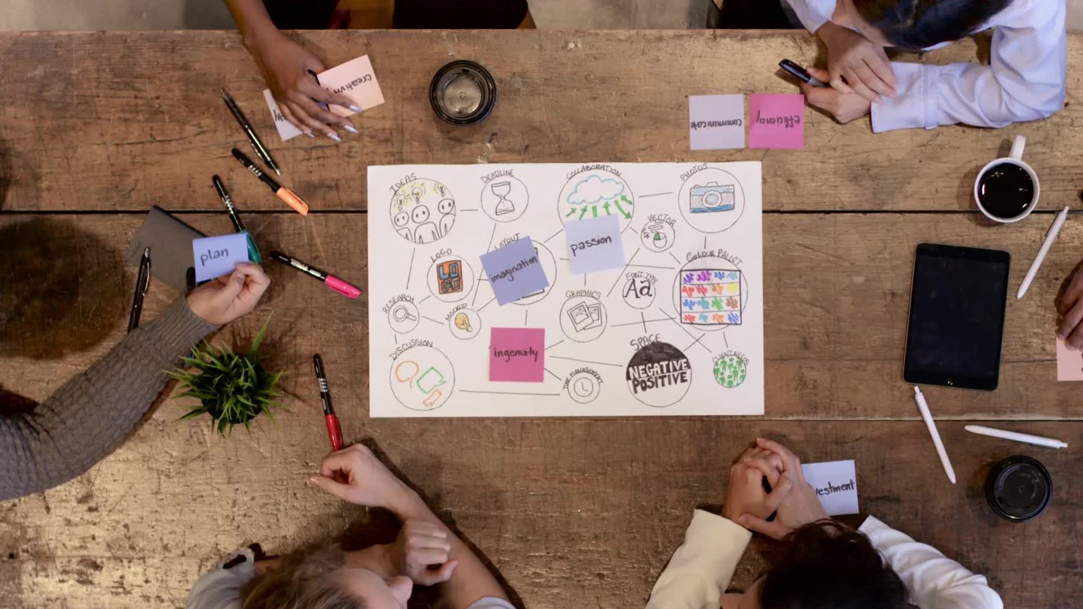
Let's Give It a Try!
Let's work together to plan a PreK retention event!

Slide 10
Spend a Day in "K"
What is the event?
Who is in charge?
When will you host it? (Be aware of DOE Kindergarten registration dates)
How will you advertise?
Work backwards on the work plan
What does the follow up afterwards look like?

Slide 11
Win the Super Bowl!!

